Slide 1
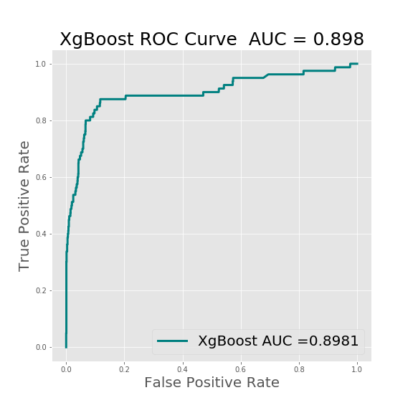
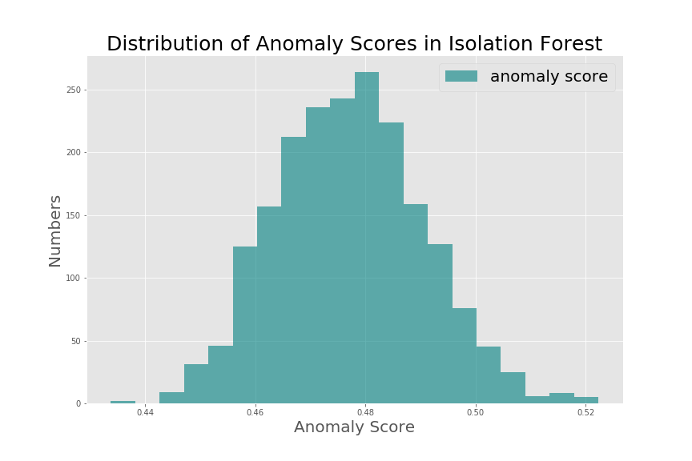
RTR Payment Fraud Detection
Human Rules
Fast to Common Fraud
Essential to Know Fraud Logic
Anomaly Detection
Identify & Quickly
Learn from
New Fraud
XgBoost
Fast & Powerful
Costly Label, Slow
to New Fraud
A Robust, Real-Time and Flexible Fraud Detection System
Model Performance Metrics: AUC > 0.9 Recall > 0.875
Final Anomaly Probability = Weighted Average of Rescaled
XgBoost Positive Probability + Anomaly Score (Anomaly Degree)
Threshold: Balance of High True Positive & Low False Positive
Cold to New Fraud
Lack of
Robustness
RTR
Slow to Common
Fraud
A Hybrid Approach: RTR Components and Features

